Slide 1
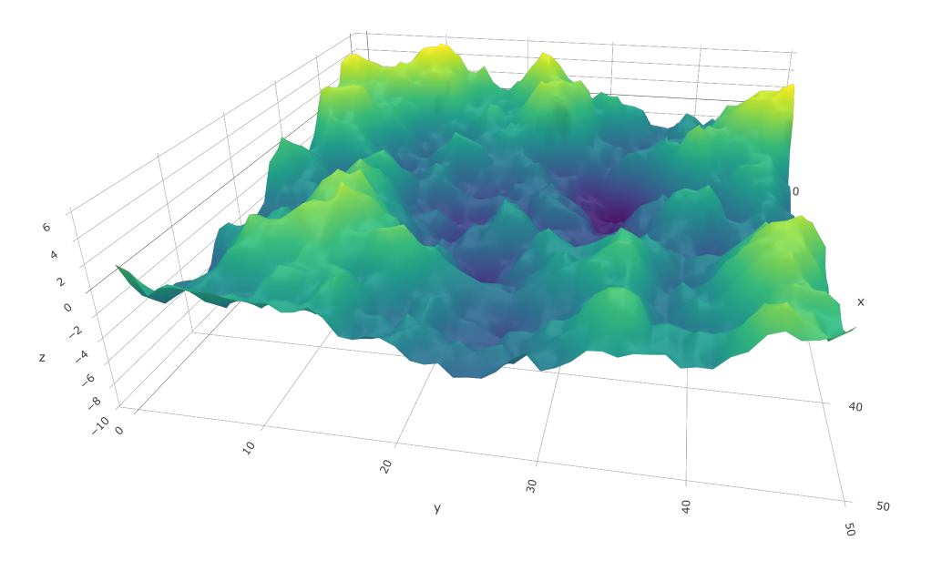
Spatial Modeling with Template Model Builder Theory and Mechanics
Andrea Havron, PhD
Research Scientist, ECS Federal, Inc.

Slide 2
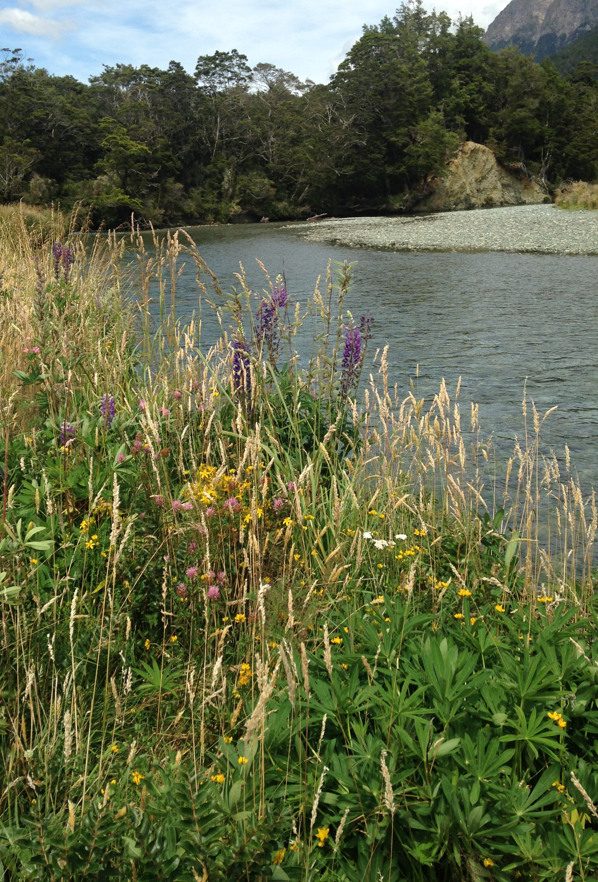
“…ecosystems without spatial structuring would be unlikely to function.”
– Pierre Legendre, 1993

Slide 3
Geography
Biology
Chance

Slide 4
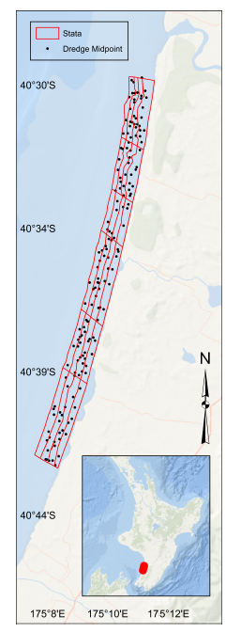
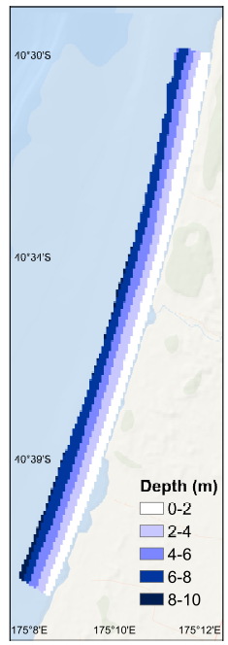
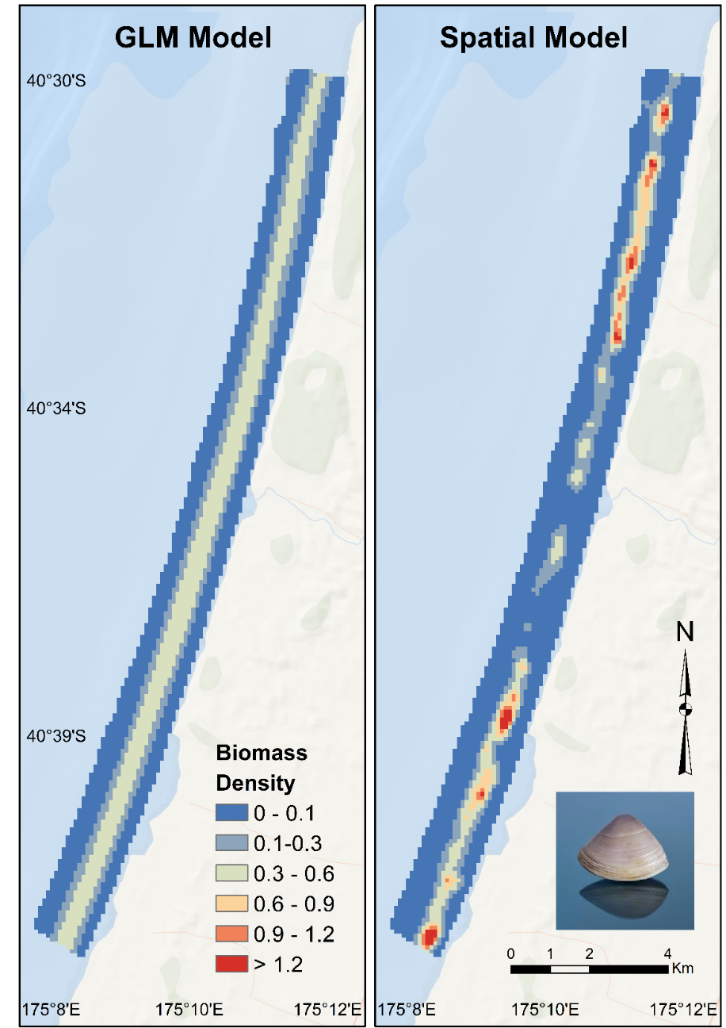
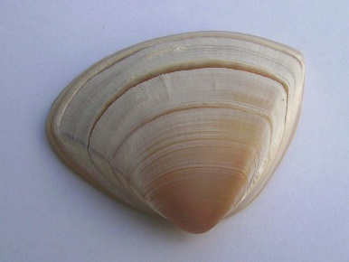
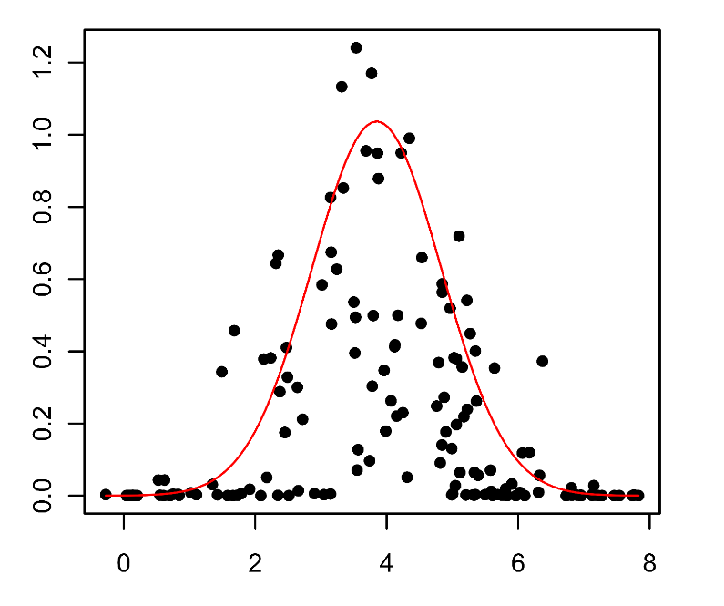
Species Distribution Modeling
Triangle Shell Surf clam
Manawatu, NZ

Slide 5
Species Distribution Modeling
Triangle Shell Surf clam
Manawatu, NZ

Slide 6
Benefits of modeling spatial correlation
Failure to model spatial correlation violates independence assumptions
Narrower confidence intervals
Inflated Type I error
We want to learn about the spatial structure
More realistic predictions of species distributions

Slide 7
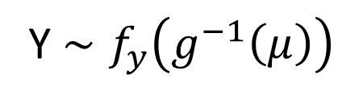
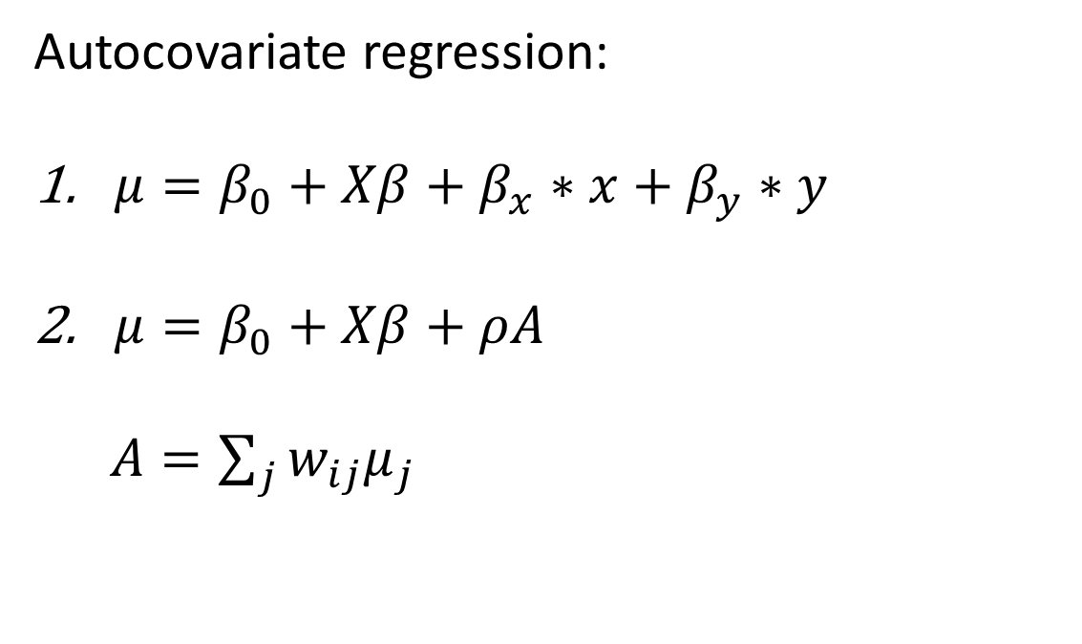
Spatial Correlation in GLMs
Y $∼f_{y}\left(g^{−1}\left(μ\right)\right)$
Autocovariate regression:
$μ=β_{0}+Xβ+β_{x}∗x+β_{y}∗y$
$μ=β_{0}+Xβ+ρA$
$A=\sum_{j}{w_{ij}μ_{j}}$

Slide 8
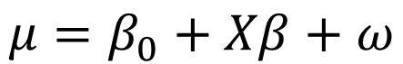
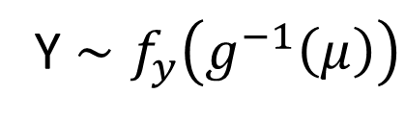
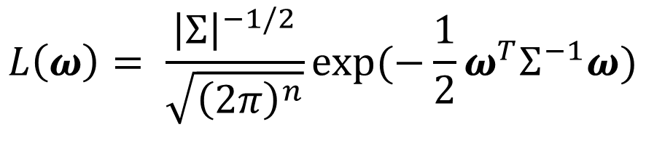
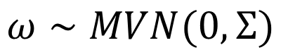
Hierarchical Spatial Model
Y $∼f_{y}\left(g^{−1}\left(μ\right)\right)$
$$μ=β_{0}+Xβ+ω$$
$$ω∼MVN(0,Σ)$$
$$L\left(ω\right)= \frac{{\left|Σ\right|}^{−1/2}}{\sqrt{{\left(2π\right)}^{n}}}exp⁡(−\frac{1}{2}ω^{T}Σ^{−1}ω)$$

Slide 9
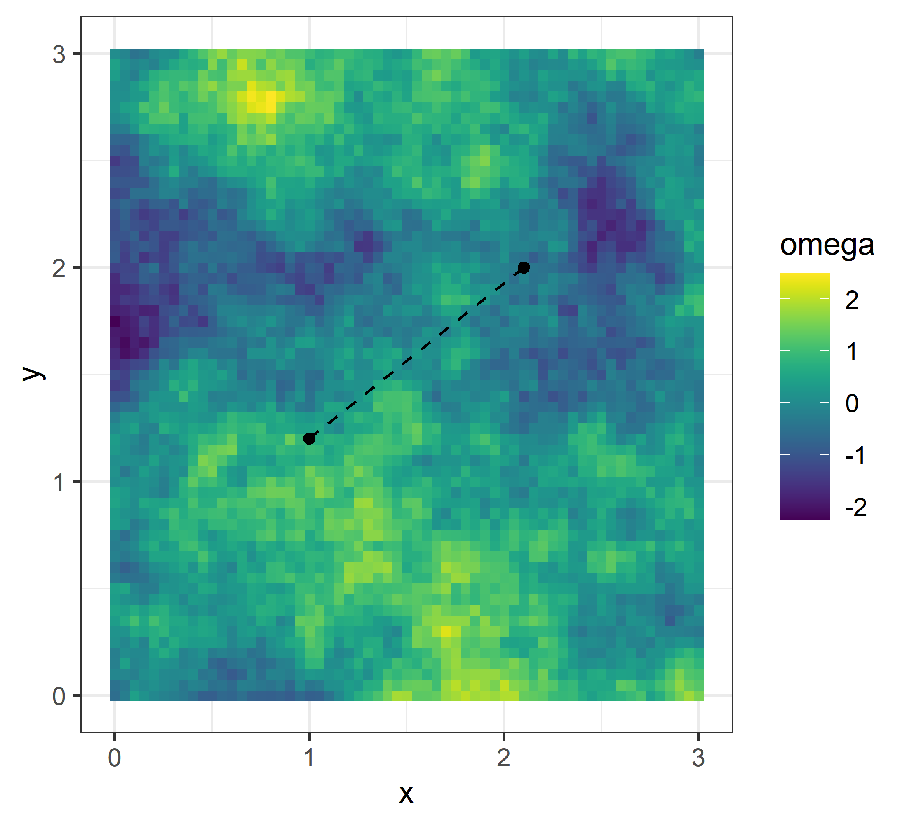
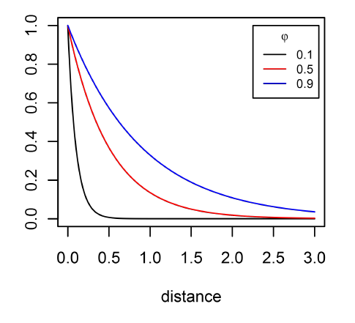

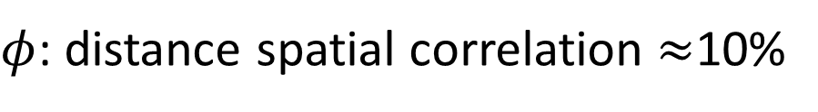
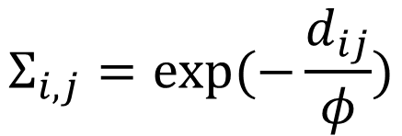
Covariance Matrix, $Σ$
Exponential Correlation
$φ$: distance spatial correlation $≈$10%
$$Σ_{i,j}=exp⁡(−\frac{d_{ij}}{φ})$$

Slide 10
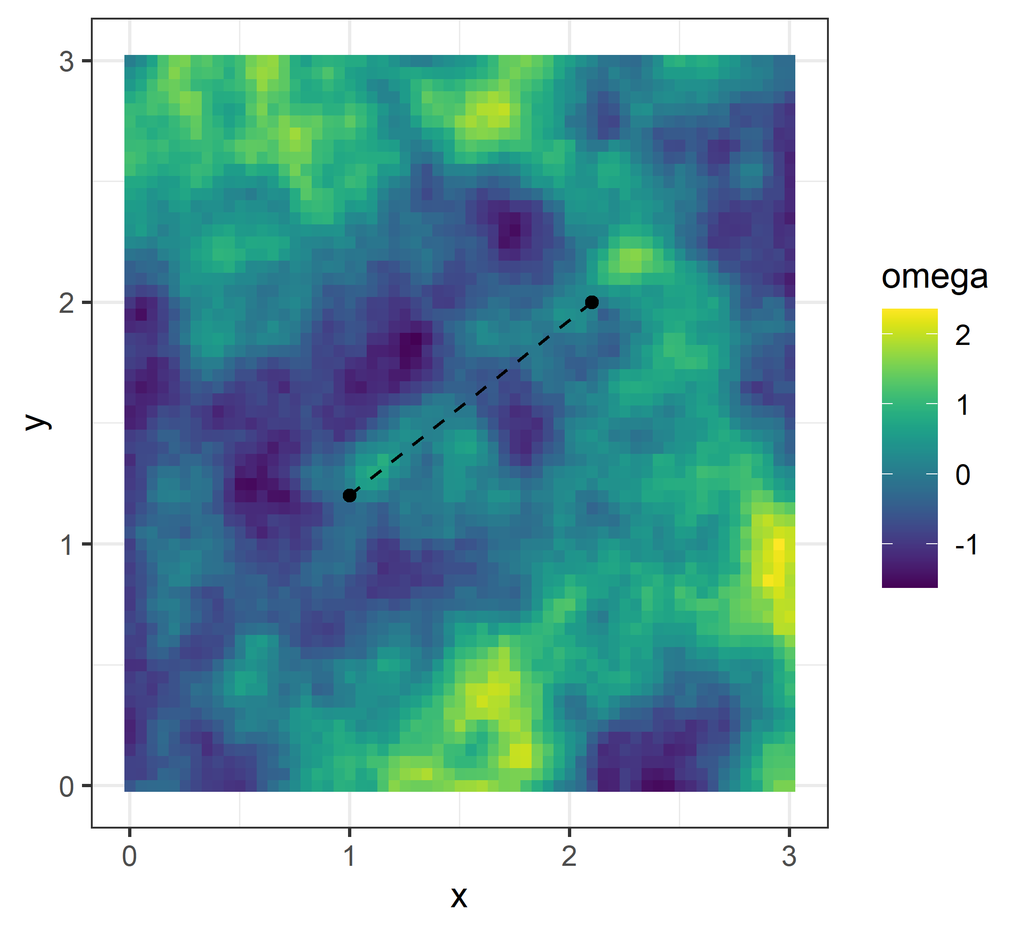
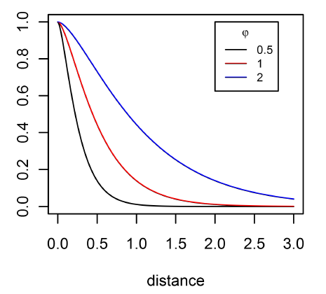
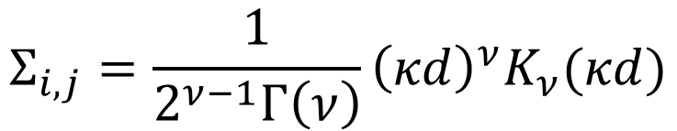
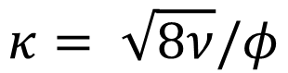
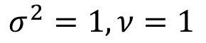
Covariance Matrix, $Σ$
Matérn Correlation
$φ$: distance spatial correlation $≈$10%
$$Σ_{i,j}=\frac{1}{2^{ν−1}Γ\left(ν\right)}{\left(κd\right)}^{ν}K_{ν}(κd)$$
$$κ= \sqrt{8ν}/φ$$
$$σ^{2}=1, ν=1$$

Slide 11
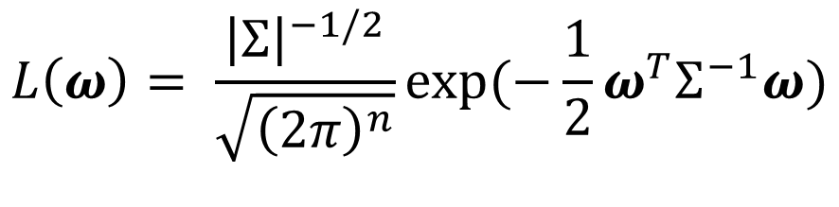
Gaussian Field
$$L\left(ω\right)= \frac{{\left|Σ\right|}^{−1/2}}{\sqrt{{\left(2π\right)}^{n}}}exp⁡(−\frac{1}{2}ω^{T}Σ^{−1}ω)$$

Slide 12
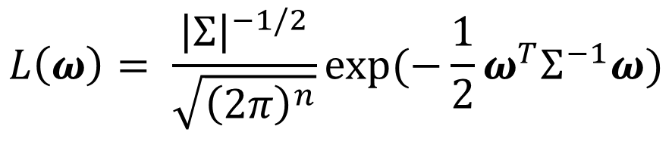
Likelihood Bottleneck
$$L\left(ω\right)= \frac{{\left|Σ\right|}^{−1/2}}{\sqrt{{\left(2π\right)}^{n}}}exp⁡(−\frac{1}{2}ω^{T}Σ^{−1}ω)$$
Operations are$𝒪(n^{3})$

Slide 13
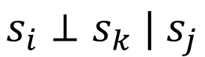
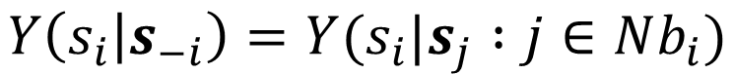
Gaussian Markov Random Field (Besag, 1974)
GMRF (Besag, 1974)
$$Y\left(s_{i} | s_{−i}\right)=Y(s_{i}|s_{j} :j∈Nb_{i})$$
s_{k}
 |  |  | s_{j}
 |  | s_{j} | s_{i} | s_{j}
 |  |  | s_{j}
s_{i}
s_{k}
s_{j}
$$s_{i}⊥s_{k} | s_{j}$$

Slide 14
GMRF
AR(1)
AR(2)
AR(3)

Slide 15
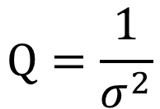
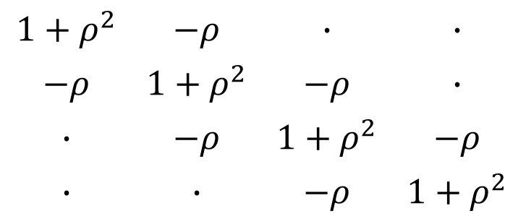
GMRF
AR(1), 1D
$$1+ρ^{2}$$ | $$−ρ$$ | $$∙$$ | $$∙$$
$$−ρ$$ | $$1+ρ^{2}$$ | $$−ρ$$ | $$∙$$
$$∙$$ | $$−ρ$$ | $$1+ρ^{2}$$ | $$−ρ$$
$$∙$$ | $$∙$$ | $$−ρ$$ | $$1+ρ^{2}$$
s_{k}
 |  |  | s_{j}
 |  | s_{j} | s_{i} | s_{j}
 |  |  | s_{j}
$$Q=\frac{1}{σ^{2}}$$

Slide 16
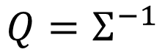
GMRF
AR(1), 1D
$$1+ρ^{2}$$ | $$−ρ$$ | $$∙$$ | $$∙$$
$$−ρ$$ | $$1+ρ^{2}$$ | $$−ρ$$ | $$∙$$
$$∙$$ | $$−ρ$$ | $$1+ρ^{2}$$ | $$−ρ$$
$$∙$$ | $$∙$$ | $$−ρ$$ | $$1+ρ^{2}$$
s_{k}
 |  |  | s_{j}
 |  | s_{j} | s_{i} | s_{j}
 |  |  | s_{j}
$$Q=\frac{1}{σ^{2}}$$
$$Q=Σ^{−1}$$

Slide 17
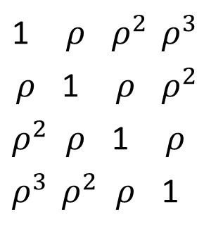
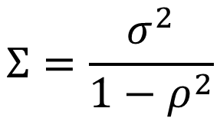
GMRF
AR(1), 1D
$$1+ρ^{2}$$ | $$−ρ$$ | $$∙$$ | $$∙$$
$$−ρ$$ | $$1+ρ^{2}$$ | $$−ρ$$ | $$∙$$
$$∙$$ | $$−ρ$$ | $$1+ρ^{2}$$ | $$−ρ$$
$$∙$$ | $$∙$$ | $$−ρ$$ | $$1+ρ^{2}$$
s_{k}
 |  |  | s_{j}
 |  | s_{j} | s_{i} | s_{j}
 |  |  | s_{j}
$$Q=\frac{1}{σ^{2}}$$
$$Q=Σ^{−1}$$
1 | $$ρ$$ | $$ρ^{2}$$ | $$ρ^{3}$$
$$ρ$$ | 1 | $$ρ$$ | $ρ^{2}$
$$ρ^{2}$$ | $$ρ$$ | 1 | $$ρ$$
$$ρ^{3}$$ | $$ρ^{2}$$ | $$ρ$$ | 1
$$Σ=\frac{σ^{2}}{1−ρ^{2}}$$

Slide 18
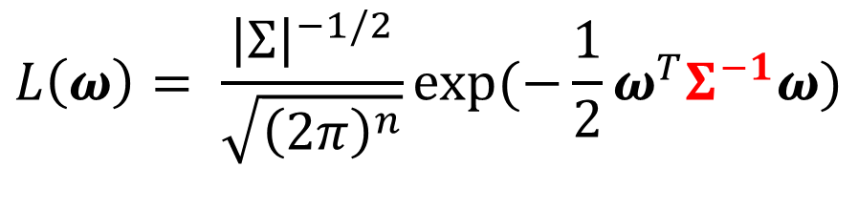
Likelihood Bottleneck
$$L\left(ω\right)= \frac{{\left|Σ\right|}^{−1/2}}{\sqrt{{\left(2π\right)}^{n}}}exp⁡(−\frac{1}{2}ω^{T}Σ^{−1}ω)$$
Operations are $𝒪(n^{3})$

Slide 19
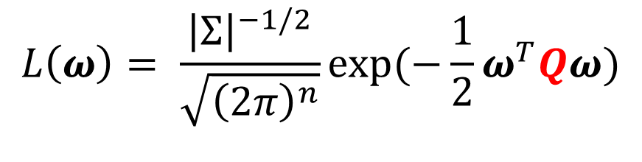
Resolving the Likelihood Bottleneck
$$L\left(ω\right)= \frac{{\left|Σ\right|}^{−1/2}}{\sqrt{{\left(2π\right)}^{n}}}exp⁡(−\frac{1}{2}ω^{T}Qω)$$
Operations are $𝒪(n^{3/2})$

Slide 20
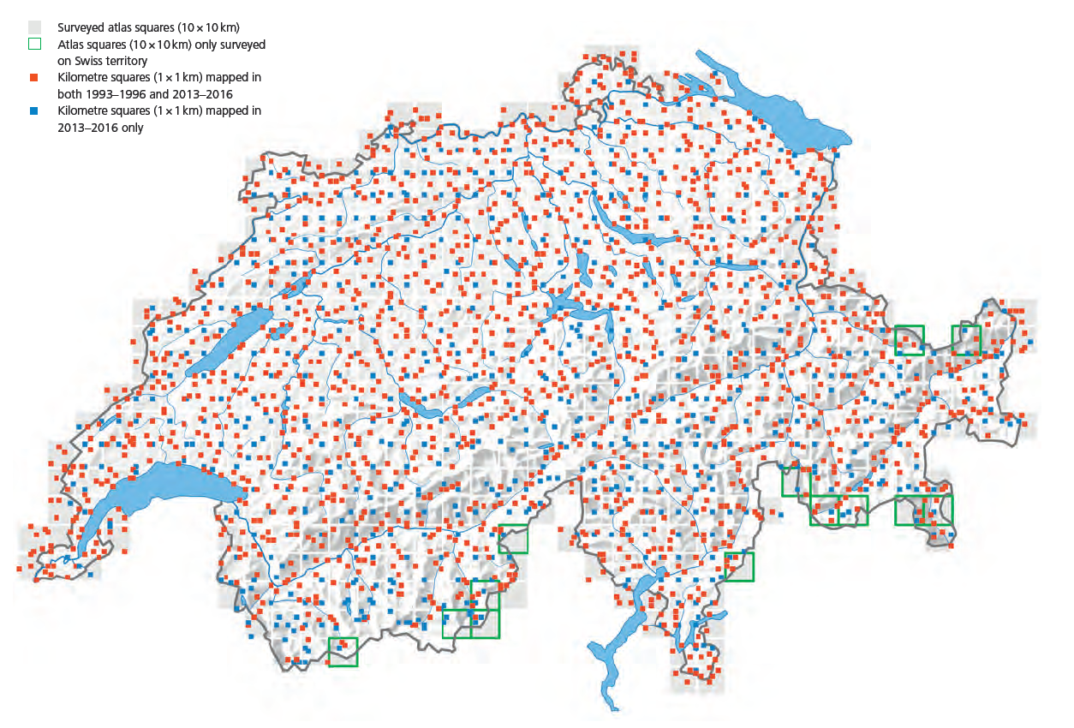
GMRF restricted to lattice data

Slide 21
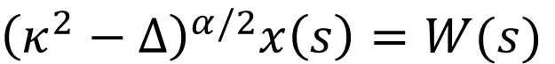
Stochastic Partial Differential Equation
SPDE (Whittle, 1963)
${\left(κ^{2}−Δ\right)}^{α/2}x\left(s\right)=W(s)$
Solution: Gaussian Field with a Matérn covariance matrix

Slide 22
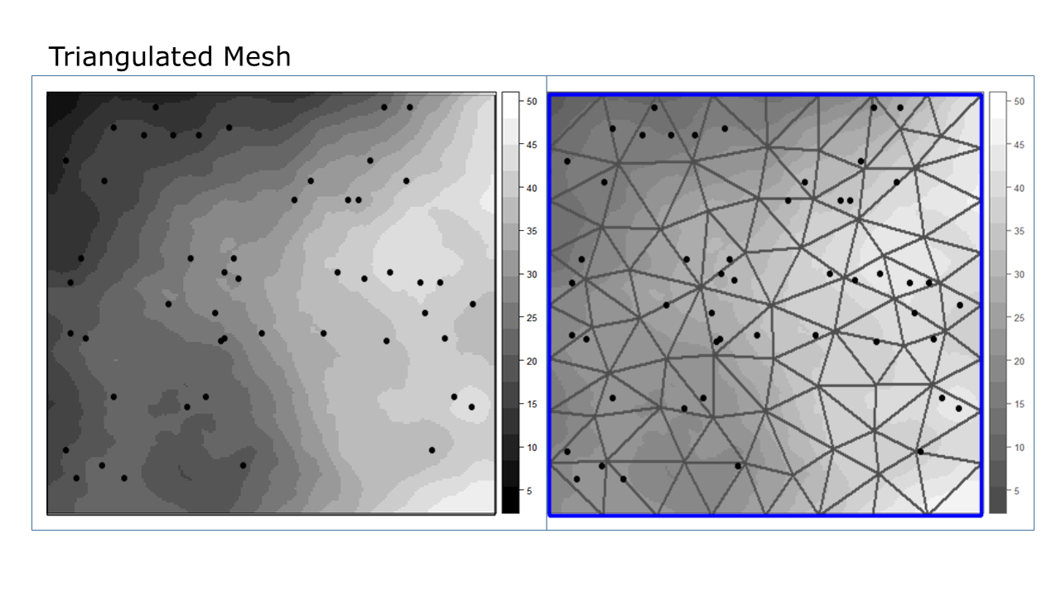
Finite Element Method approach to the SPDE
FEM-SPDE (Lindgren et al., 2011)

Slide 23
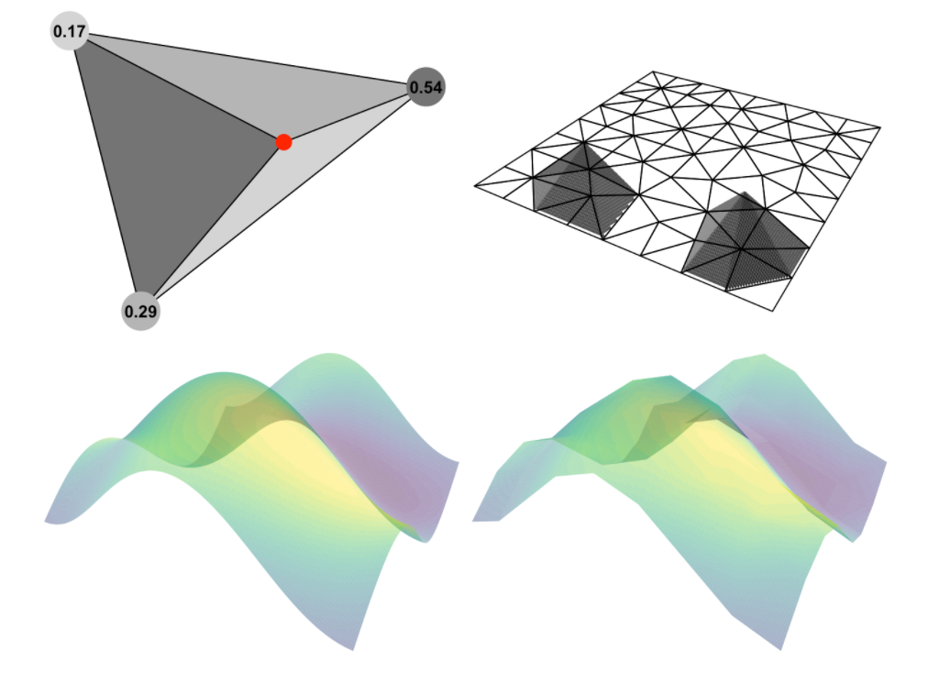
Finite Element Method approach to the SPDE
FEM-SPDE (Lindgren et al., 2011)
Image source: Krainski et al. 2019

Slide 24
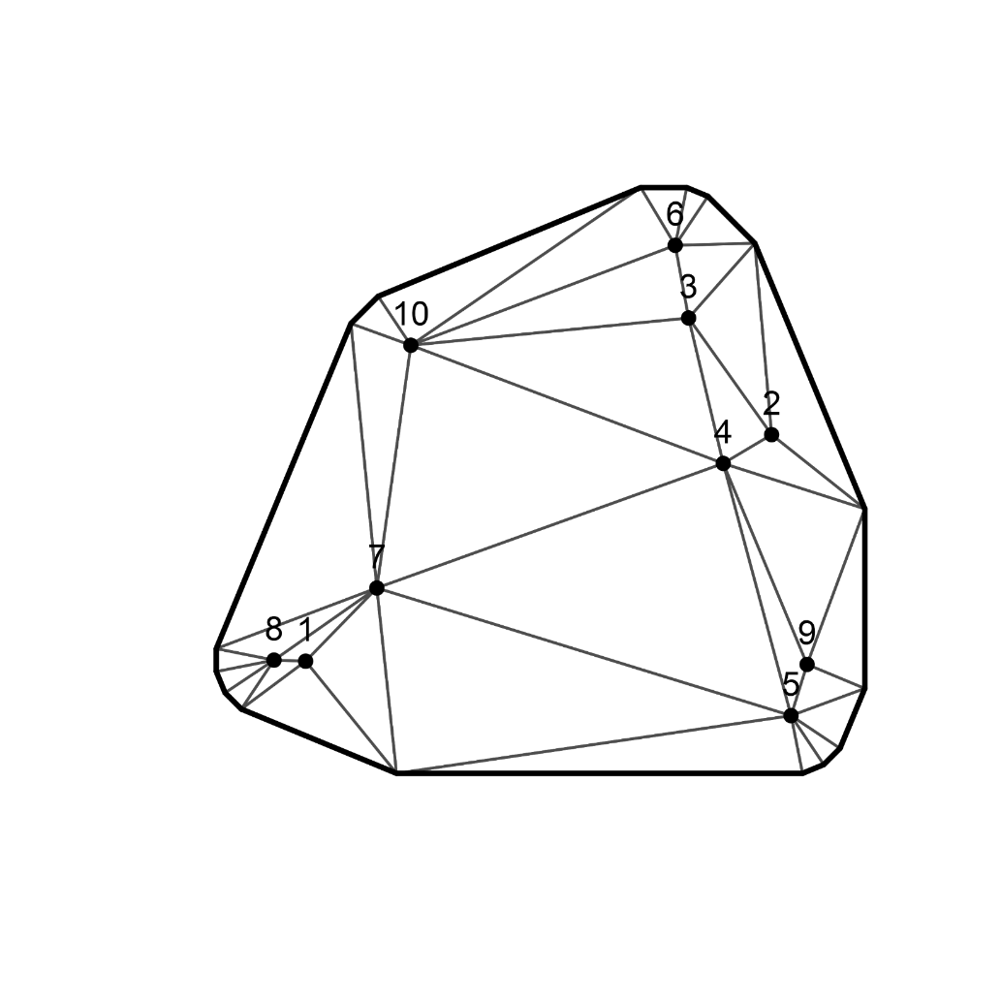
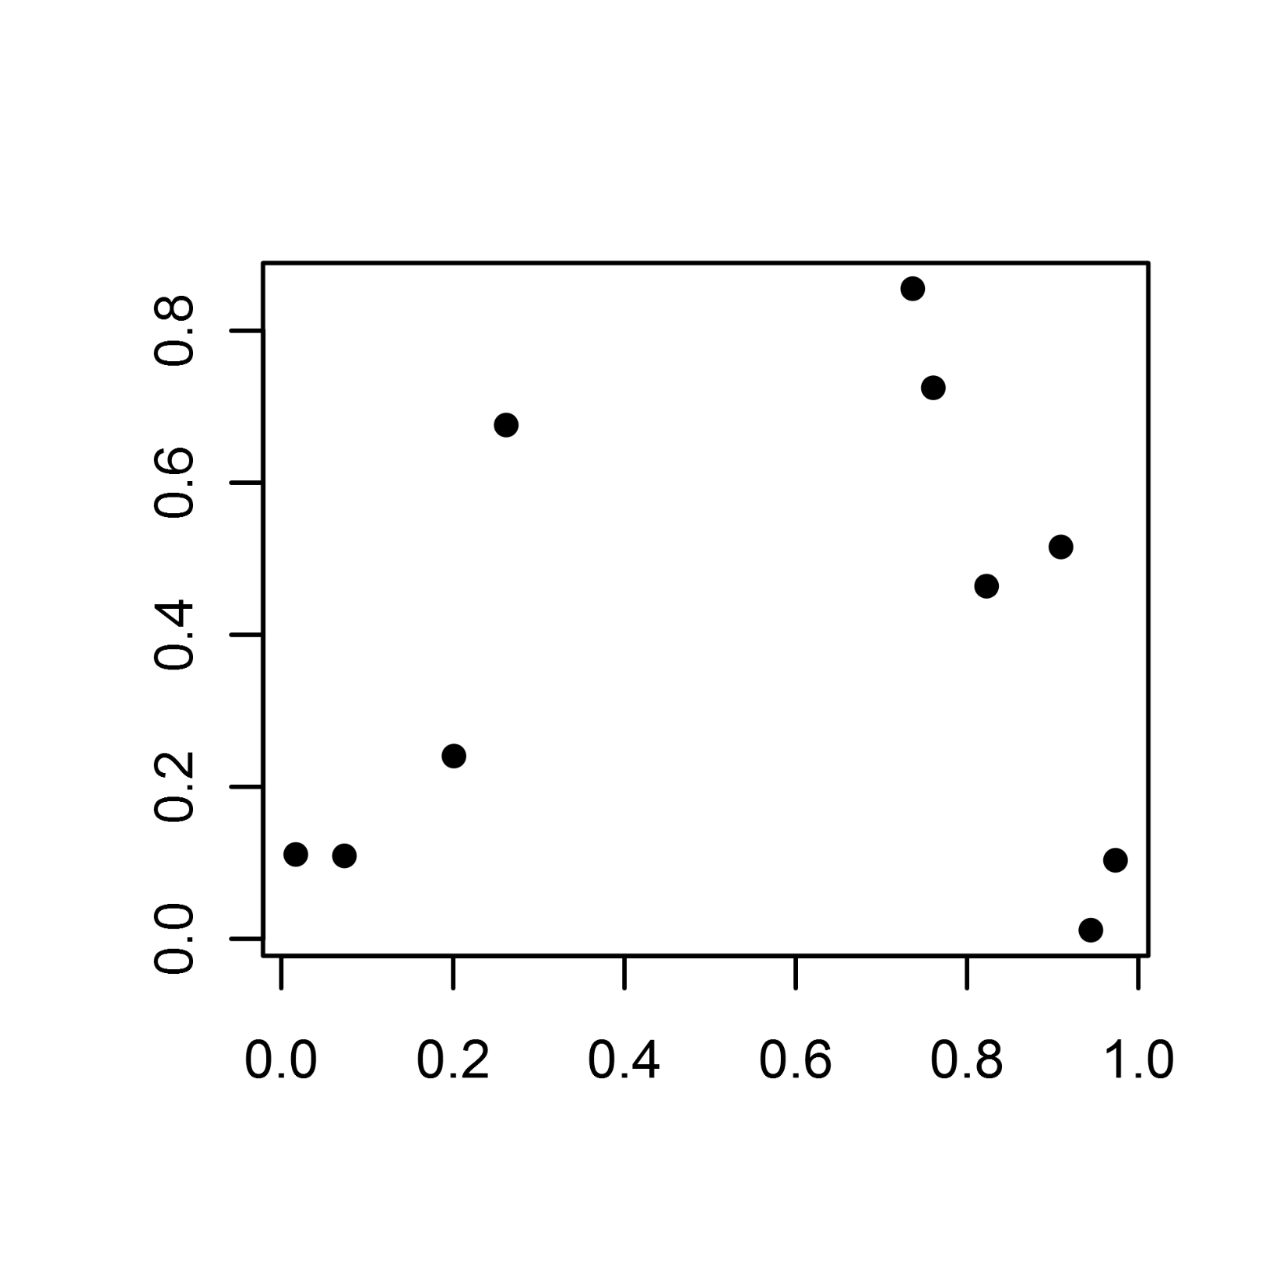
FEM-SPDE with R-INLA
inla.mesh.2d()
inla.mesh.create()

Slide 25
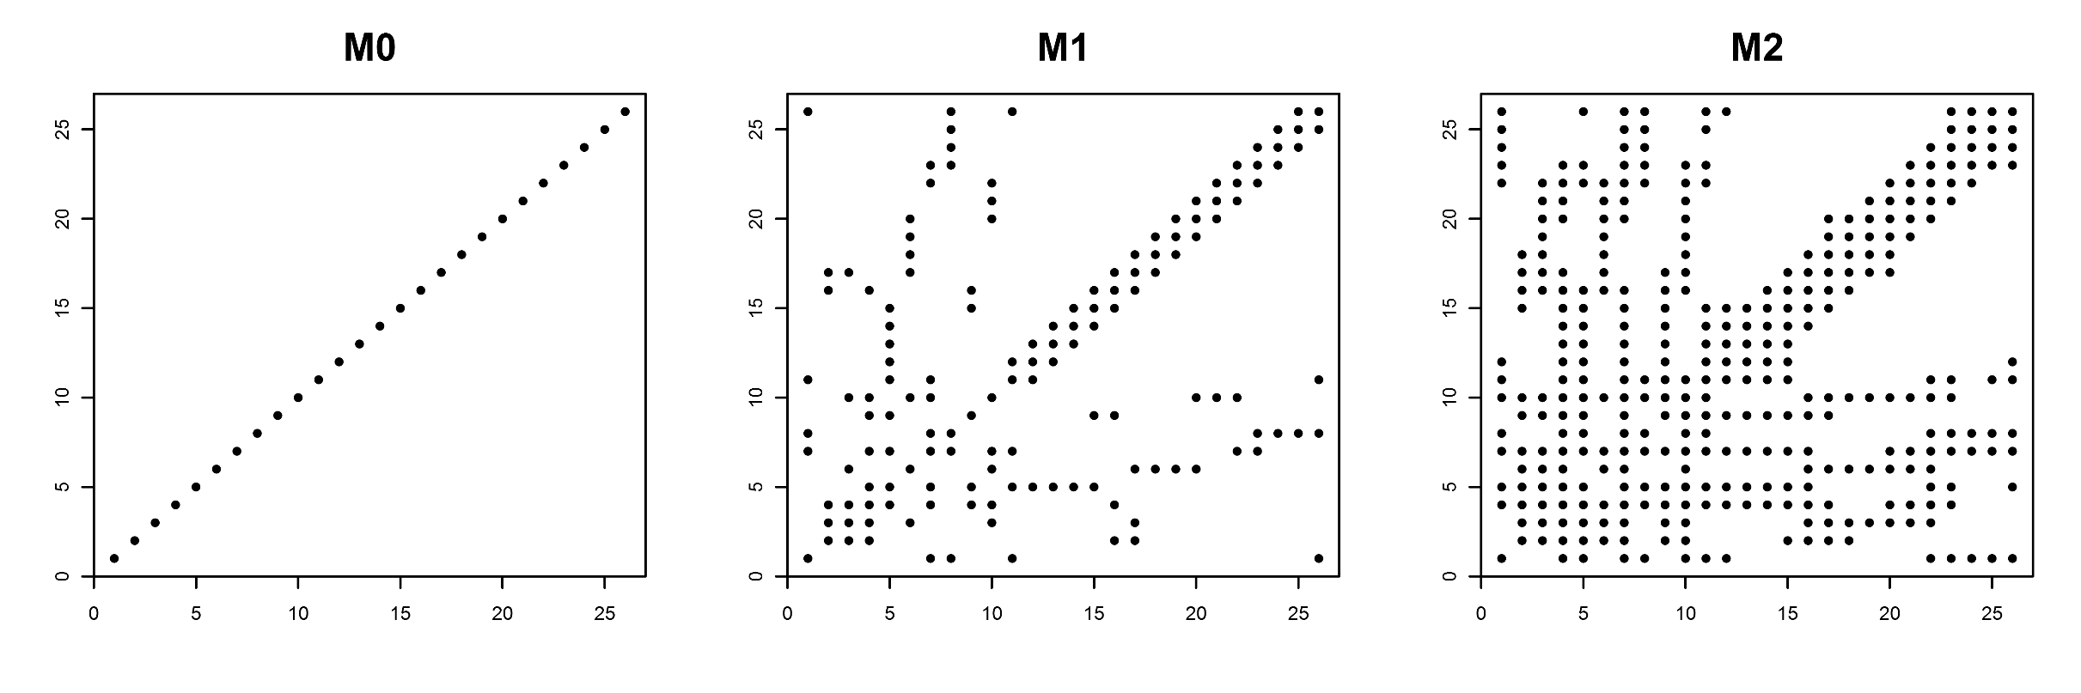
FEM-SPDE with R-INLA
inla.spde2.matern()

Slide 26
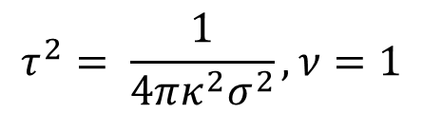
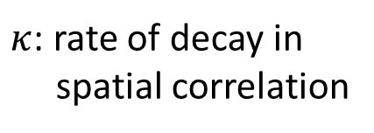
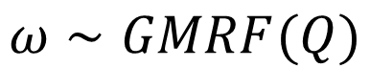
Precision matrix from R-INLA output
$$Q={τ^{2}(κ}^{4}M_{1}+2κ^{2}M_{1}+M_{2})$$
$κ$: rate of decay in
spatial correlation
$$ω∼GMRF(Q)$$
$$τ^{2}= \frac{1}{4πκ^{2}σ^{2}}, ν=1$$

Slide 27
Template Model Builder
TMB (Kristensen et al., 2015)
Model written in C++
R interface used to run model
Laplace approximation
Automatic Differentiation

Slide 28
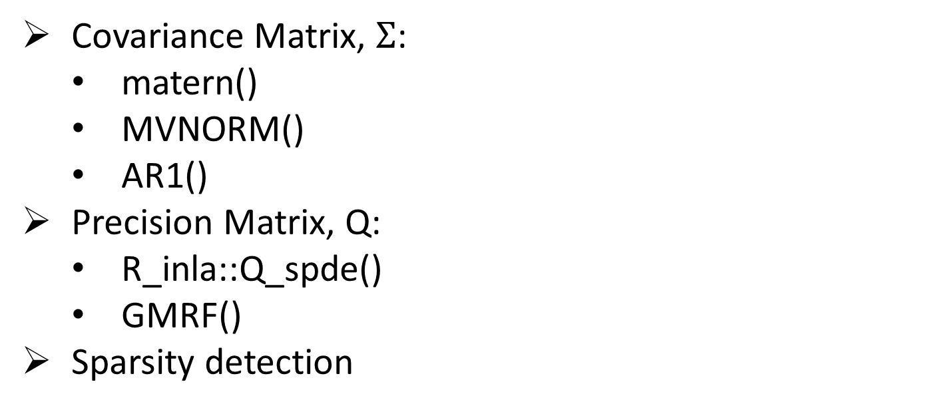
TMB’s Spatial Functionality
Covariance Matrix, $Σ$:
matern()
MVNORM()
AR1()
Precision Matrix, Q:
R_inla::Q_spde()
GMRF()
Sparsity detection

Slide 29
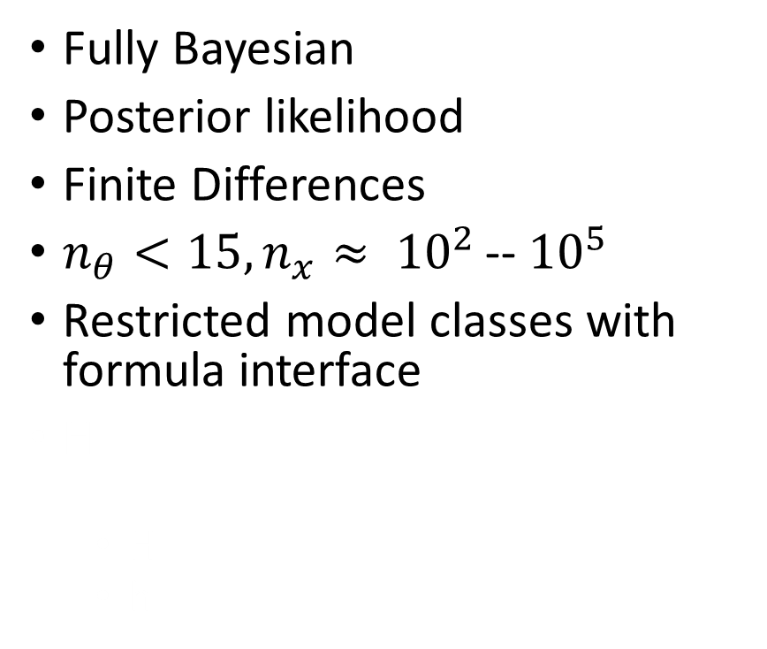
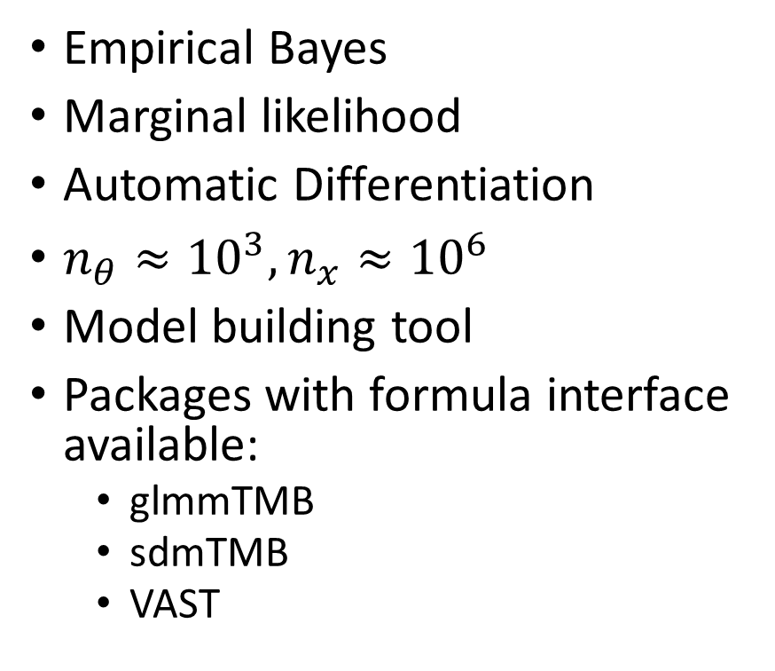
TMB versus INLA
TMB
INLA
Empirical Bayes
Marginal likelihood
Automatic Differentiation
$n_{θ}≈{10}^{3}, n_{x}≈{10}^{6}$
Model building tool
Packages with formula interface available:
glmmTMB
sdmTMB
VAST
Fully Bayesian
Posterior likelihood
Finite Differences
$n_{θ}<15, n_{x}≈ {10}^{2 }$-- ${10}^{5}$
Restricted model classes with formula interface
H
H
h

Slide 30
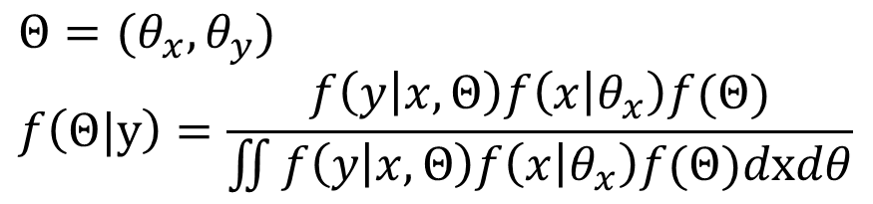
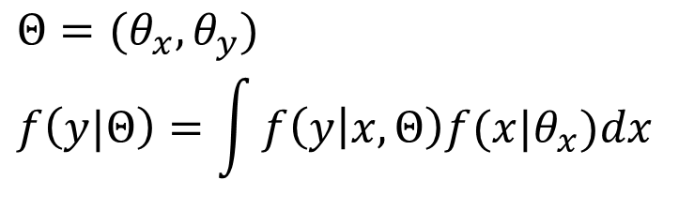
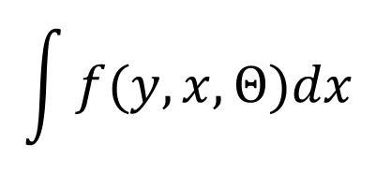
Laplace Approximation
TMB
INLA
H
h
$$Θ=(θ_{x},θ_{y})$$
$$f\left(y|Θ\right)=\int{f\left(y | x,Θ\right)f(x|θ_{x})dx}$$
$$Θ=(θ_{x},θ_{y})$$
$$f\left(Θ|y\right)=\frac{f\left(y | x,Θ\right)f\left(x | θ_{x}\right)f(Θ)}{\iint{f\left(y | x,Θ\right)f\left(x | θ_{x}\right)f(Θ)dxdθ}}$$
$$\int{f(y,x,Θ)dx}$$

Slide 31
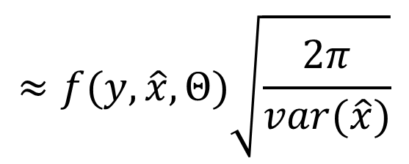


Laplace Approximation
$$\int{f(y,x,Θ)dx}$$
$$≈f(y,\hat{x},Θ)\sqrt{\frac{2π}{var(\hat{x})}}$$
$$≈f\left(y,\hat{x},Θ\right){\sqrt{2π}}^{m}{\det\left(H\right)}^{−1/2}$$

Slide 32

Why differentiation?

Slide 33
Types of differentiation
Numerical differentiation
Approximation
Truncation error versus round-off error
Higher order calculations difficult Restrictions on parameters size
Automatic Differentiation
Accurate derivatives calculated automatically using the chain rule
Calculates higher order derivatives
Can handle large number of parameters

Slide 34
Automatic Differentiation
TMB
Calculates derivatives of joint likelihood and Laplace approximation to the marginal to find optimum parameter values
Stan
Hamilton MCMC uses the gradient to direct the sampler towards the posterior mode

Slide 35

TMB Extensions
Temporal and spatio-temporal modeling
AR1() function to calculate likelihood of autoregressive process
SEPERABLE() function to introduce seperability between space/time
Multi-species modeling
Spatial latent variable models:
$μ_{i}=β_{0}+X_{i}β_{j}+\sum_{f}{Ω_{ ,f}L_{f,j}}$
For details, see Thorson, 2015

Slide 36
References
Besag, J. 1974. Spatial interaction and the statistical analysis of lattice systems. Journal of the Royal Statistical Society, Series B. 36:192-236.
Krainski, ET. et al. 2019. Advanced Spatial Modeling with Stochastic Partial Differential Equations Using R and INLA. Chapman & Hall/CRC Press. Boca Raton, FL. https://becarioprecario.bitbucket.io/spde-gitbook/index.html
Lindgren, F. et al. 2011. An explicit link between Gaussian fields and Gaussian Markov random fields: the stochastic partial differential equation approach. Journal of the Royal Statistical Society, series B. 73:423-498.
Thorson, JT et al. 2015. Spatial factor analysis: a new tool for estimating joint species distributions and correlations in species range. Methods in Ecology and Evolution. 6:627-637.
Whittle, P. 1963. Stochastic processes in several dimensions. Bulletin of International Statistical Institute. 40:974-994.

